Slide 1
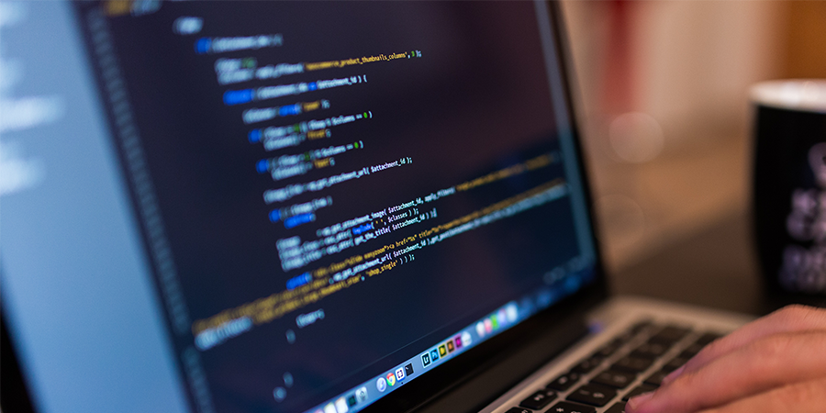
Programming with JavaScript and jQuery
Day 2

Slide 2
Chapter 3
Building Arrays and Controlling Flow

Slide 3
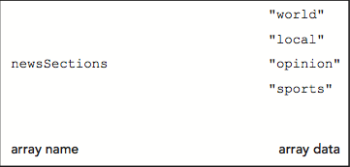
Arrays
Array
Set of data represented by a single variable name.
You can think of an array as a collection of variables contained within a single variable.
Figure 3-1 Conceptual illustration of an array

Slide 4
Declaring and Initializing Arrays
Array literal
A single statement that declares a variable and specifies array values as its conent.
The most common way to create an array.
Syntax
var name = [value1, value2, value3, …];
Example:
Create an array named newsSections containing 4 strings as elements
var newsSections = ["world","local","opinion","sports"]

Slide 5
Declaring and Initializing Arrays
Element
Each piece of data contained in an array
Index
Element’s numeric position within the array
Array element numbering
Starts with index number of zero (0)
Reference element using its index number
Example: to reference the 2nd element in the newsSections array
^{newsSections[1]}

Slide 6
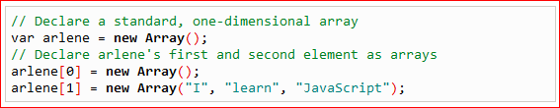
Declaring and Initializing Arrays
Assigning values to individual array elements
Include the array index for an individual element
Example:
Add value "entertainment" as fifth element of newsSections array
Multidimensional array example:
newsSections[4] = "entertainment";
http://freewebdesigntutorials.com/javaScriptTutorials/jsArrayObject/multiDimensionalArrays.htm

Slide 7
Declaring and Initializing Arrays
Can create an array without any elements
Add new elements as necessary
Array size can change dynamically
^{var colors = [];}
^{colors[2] = "yellow";}
JavaScript values assigned to array elements can be different data types.

Slide 8
Accessing Element Information
To access an element’s value:
Include brackets and element index
Examples:
var newsSections = ["world","local","opinion","sports"]
var sec1Head = document.getElementById("section1");
var sec2Head = document.getElementById("section2");
var sec3Head = document.getElementById("section3");
sec1Head.innerHTML = newsSections[0]; // "world"
sec2Head.innerHTML = newsSections[1]; // "local"
sec3Head.innerHTML = newsSections[2]; // "opinion"

Slide 9
Modifying Elements
To modify values in existing array elements
Include brackets and element index
Can change a value assigned to an array element
Example:
^{newsSections[4] = "living";}

Slide 10
Determining the Number of Elements in an Array
length property
Returns the number of elements in an array
Syntax
name.length;

Slide 11
Using the Array Object
JavaScript represents arrays with the Array object
Contains a special constructor named Array()
Constructor
Special function type used as the basis for creating reference variables
Syntax
var newsSections = new Array(6);
Array literals preferred
Easier

Slide 12
Referencing Default Collections of Elements
getElementsByTagName() method
Can reference web page element by looking up all elements of a certain type in document and referencing one element in that collection
Resulting collection uses syntax similar to arrays
Example:
document.getElementsByTagName("li")[2]

Slide 13
Repeating Code
Loop statement
Control flow statement repeatedly executing a statement or a series of statements
While a specific condition is true or until a specific condition becomes true
Three types of loop statements
while statements
do/while statements
for statements

Slide 14
while Statements
while statement
Repeats a statement or series of statements
As long as a given conditional expression evaluates to a truthy value
Syntax
while (expression) {
statements
}
Iteration
Each repetition of a looping statement

Slide 15
while Statements
Counter
Variable incremented or decremented with each loop statement iteration
Examples:
while statement using an increment operator
while statement using a decrement operator
while statement using the *= assignment operator

Slide 16
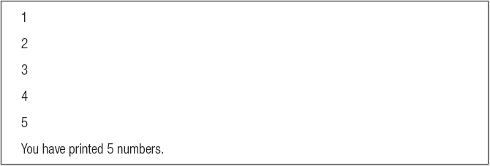
while Statements
var count = 1;
while (count <= 5) {
document.write(count + "<br />");
count++;
}
document.write("<p>You have printed 5 numbers.</p>");
Result in browser:

Slide 17
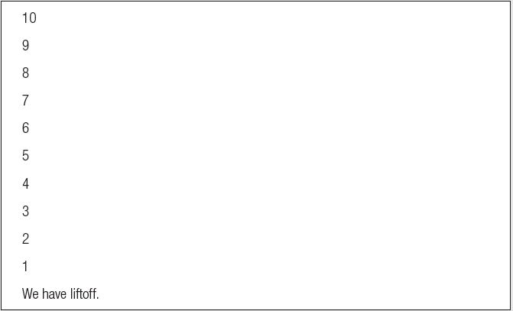
while Statements
var count = 10;
while (count > 0) {
document.write(count + "<br />");
count--;
}
document.write("<p>We have liftoff.</p>");
Result in browser:

Slide 18
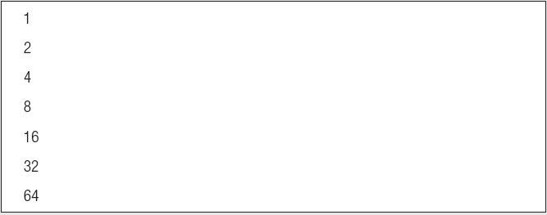
while Statements
var count = 1;
while (count <= 100) {
document.write(count + "<br />");
count *= 2;
}
Result in browser:

Slide 19
while Statements
Infinite loop
Loop statement that never ends
Conditional expression: never false
Example:
What problem may arise from executing an infinite loop?
var count = 1;
while (count <= 10) {
window.alert("The number is " + count + ".");
}

Slide 20
while Statements
Example:
assigning array element values to table cells:
function addColumnHeaders() {
var i = 0;
while (i < 7) {
document.getElementsByTagName("th")[i].innerHTML = daysOfWeek[i];
i++;
}
}

Slide 21
do/while Statements
do/while statement
Executes a statement or statements once
Then repeats the execution as long as a given conditional expression evaluates to a truthy value
Syntax
What difference do you see between while and do/while loops?
do {
statements;
} while (expression);

Slide 22
do/while Statements
Examples:
var count = 2;
do {
document.write("<p>The count is equal to " + count + ".</p>");
count++;
} while (count < 2);
var count = 2;
while (count < 2) {
document.write("<p>The count is equal to " + count + ".</p>");
count++;
}

Slide 23
do/while Statements
Example:
adding days of week with a do/while statement instead of a while statement
var i = 0;
do {
document.getElementsByTagName("th")[i].innerHTML = daysOfWeek[i];
i++;
} while (i < 7);

Slide 24
for Statements
for statement
Repeats a statement or series of statements
As long as a given conditional expression evaluates to a truthy value
Can also include code that initializes a counter and changes its value with each iteration
Syntax
for (counter_declaration; condition; counter_operation) {
statements
}

Slide 25
for Statements
Steps when JavaScript interpreter encounters a for loop
1. Counter variable declared and initialized
2. for loop condition evaluated
3. If condition evaluation in Step 2 returns TRUE:
for loop statements execute, Step 4 occurs, and the process starts over again with Step 2
If condition evaluation in Step 2 returns FALSE:
for statement ends
Next statement following the for statement executes
4. Update statement in the for statement executed

Slide 26
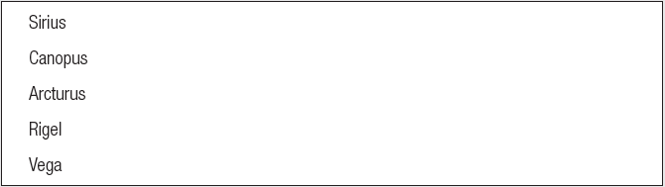
for Statements
var brightestStars = ["Sirius", "Canopus", "Arcturus", "Rigel", "Vega"];
for (var count = 0; count < brightestStars.length; count++) {
document.write(brightestStars[count] + "<br />");
}
Result in browser:

Slide 27
for Statements
Example:
addColumnHeaders() function with a for statement instead of a do/while statement
function addColumnHeaders() {
for (var i = 0; i < 7; i++) {
document.getElementsByTagName("th")[i].innerHTML = daysOfWeek[i];
}
}

Slide 28
Using continue Statements to Restart Loop Execution
continue statement
Halts a looping statement
Restarts the loop with a new iteration
Used to stop a loop for the current iteration
Have the loop to continue with a new iteration
Examples:
for loop with a continue statement

Slide 29
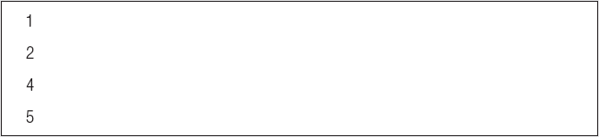
Using continue Statements to Restart Loop Execution
for (var count = 1; count <= 5; count++) {
if (count == 3) {
continue;
}
document.write("<p>" + count + "</p>");
}
Result in browser:

Slide 30
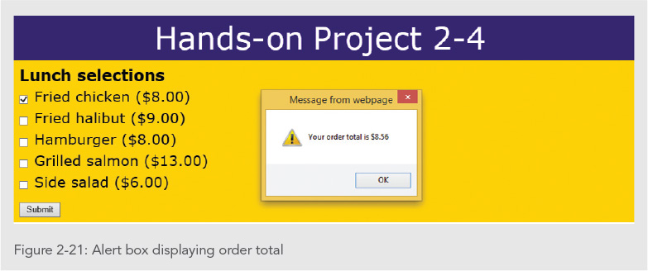
Exercise
Modify the “Lunch Selections” exercise you did yesterday to use a multi-dimensional array and a loop. Put all menu items in the array. Loop through the array to display the menu.
Hint:
lMenu[0] = [‘Chicken', 8.00];
lMenu[1] = [‘Halibut', 9.00];
…
for (i = 0; i < lMenu.length; i++){
document.writeln(lMenu[i][0] + " " + lMenu[i][1]);
}

Slide 31
Making Decisions
Decision making
Process of determining the order in which statements execute in a program
Decision-making statements, decision-making structures, or conditional statements
Special types of JavaScript statements used for making decisions
if statement
Most common type of decision-making statement

Slide 32
if Statements
Used to execute specific programming code IF conditional expression evaluation returns TRUE
Syntax
if (condition) {
statements
}
After the if statement executes:
Any subsequent code executes normally

Slide 33
if/else Statements
Executes one action if the condition is TRUE and a different action if the condition is FALSE
Syntax for an if . . . else statement
if (expression) {
statements
} else {
statements
}

Slide 34
if/else Statements
Example:
var today = "Tuesday"
if (today === "Monday") {
document.write("<p>Today is Monday</p>");
}
else {
document.write("<p>Today is not Monday</p>");
}

Slide 35
Nested if and if/else Statements
Nested decision-making structures
One decision-making statement contains another decision-making statement
Nested if statement
An if statement contained within an if statement or within an if/else statement
Nested if/else statement
An if/else statement contained within an if statement or within an if/else statement
Example:
var salesTotal = 75;
if (salesTotal > 50) {
if (salesTotal < 100) {
document.write("<p>The sales total is
between 50 and 100.</p>");
}
}

Slide 36
else if constructions
Compact version of nested if/else statements
combine an else statement with its nested if statement
requires fewer characters
easier to read
if (gameLocation[i] === "away") {
paragraphs[1].innerHTML = "@ ";
}
else {
if (gameLocation[i] === "home") {
paragraphs[1].innerHTML = "vs ";
}
}
if (gameLocation[i] === "away") {
paragraphs[1].innerHTML = "@ ";
}
else if (gameLocation[i] === "home") {
paragraphs[1].innerHTML = "vs ";
}

Slide 37
switch Statements
Controls program flow by executing a specific set of statements
Dependent on an expression value
Compares expression value to value contained within a case label
case label
Represents a specific value
Contains one or more statements that execute:
If case label value matches the switch statement’s expression value
switch (expression) {
case label:
statements;
break;193
case label:
statements;
break;
...
default:
statements;
break;
}

Slide 38
switch Statements
function city_location(americanCity) {
switch (americanCity) {
case "Boston":
return "Massachusetts";
break;
case "Chicago":
return "Illinois";
break;
case "Los Angeles":
return "California";
break;
case "Miami":
return "Florida";
break;
case "New York":
return "New York";
break;
default:
return "United States";
break;
}
}
document.write("<p>" + city_location("Boston") + "</p>");
default label
Executes when the value returned by the switch statement expression does not match a case label
When a switch statement executes:
Value returned by the expression is compared to each case label
In the order in which it is encountered
break statement
Ends execution of a switch statement
Should be final statement after each case label

Slide 39
Exercise
Add a conditional statement to the “Lunch Selections” exercise. If the user selects more than three options, display an alert message that says “You can select up to three options”.

Slide 40
Introduction to Debugging
Programming languages have syntax (rules)
Logic
Order in which various program parts run (execute)
Bug
Any program error
Causes program to function incorrectly due to incorrect syntax or flaws in logic
Debugging
Process of tracing and resolving errors in a program

Slide 41
Understanding Syntax Errors
Syntax errors
Occur when interpreter fails to recognize code
Causes
Incorrect use of JavaScript code
References to non-existent objects, methods, variables
Run-time errors
Occur when interpreter encounters a problem while program executing
Not necessarily JavaScript language errors
Occur when interpreter encounters code it cannot execute
Run-time error can be caused by a syntax error

Slide 42
Identifying Logic Errors
Logic errors
Flaw in a program’s design
Prevents program from running as anticipated
“Logic” reference
Execution of program statements and procedures in the correct order to produce the desired results
Example: multiplying instead of dividing
var divisionResult = 10 * 2;
document.write("Ten divided by two is equal to " + divisionResult);
Can the JavaScript interpreter catch logic errors as the one above?

Slide 43
Identifying Logic Errors
Example: infinite loop
for (var count = 10; count >= 0; count) {
document.write("We have liftoff in " + count);
}
Example: infinite loop corrected
for (var count = 10; count >= 0; count--) {
document.write("We have liftoff in " + count);
}

Slide 44
Interpreting Error Messages
First line of defense in locating JavaScript bugs:
Browser console displays
Line number where error occurred
Error description
Run-time errors
Error messages generated by a web browser
Can be caused by syntax errors but not by logic errors
Example:
function missingClosingBrace() {
var message = "This function is missing a closing brace.";
window.alert(message);

Slide 45
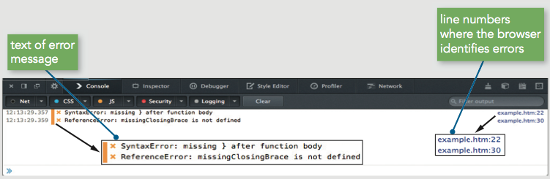
Interpreting Error Messages
Figure 4-3 Firefox error messages

Slide 46
Interpreting Error Messages
Error message
Displays error’s general location in a program
Not an exact indicator
Browsers do not strictly enforce JavaScript syntax
Mitigating bugs in JavaScript programs
Always use good syntax
Thoroughly test with every browser type, version
Test browser if used by more than one percent of the market
Syntax errors can be difficult to pinpoint
A few common techniques are helpful in tracking down bugs

Slide 47
Tracing Errors with the window.alert() Method
Tracing
Examining statements in an executing program
window.alert() method
A useful way to trace JavaScript code
Place at different points within program
Used to display variable or array contents or value returned from a function
Use multiple window.alert() methods
Check values as code executes
Example: function not returning correct result of 485
Returning 5169107

Slide 48
Tracing Errors with the window.alert() Method
function calculatePay() {
var payRate = 15; numHours = 40;
var grossPay = payRate * numHours;
alert(grossPay);
var federalTaxes = grossPay * .06794;
var stateTaxes = grossPay * .0476;
var socialSecurity = grossPay * .062;
var medicare = grossPay * .0145;
var netPay = grossPay - federalTaxes;
netPay *= stateTaxes;
netPay *= socialSecurity;
netPay *= medicare;
return netPay;
}

Slide 49
Tracing Errors with the window.alert() Method
Drawback
Must close each dialog box for code to continue executing
Use selectively at key points
Place debugging code at different indent level to distinguish from program code

Slide 50
Tracing Errors with the console.log() Method
Trace a bug by analyzing a list of values
Logging
writing values directly to the console using the console.log() method
syntax: console.log(value);
can log string literal, variable value, or combination

Slide 51
Tracing Errors with the console.log() Method
function calculatePay() {
var payRate = 15; numHours = 40;
var grossPay = payRate * numHours;
console.log("grossPay is " + grossPay);
var federalTaxes = grossPay * .06794;
var stateTaxes = grossPay * .0476;
var socialSecurity = grossPay * .062;
var medicare = grossPay * .0145;
var netPay = grossPay - federalTaxes;
console.log("grossPay minus federalTaxes is " + netPay);
netPay *= stateTaxes;
console.log("netPay minus stateTaxes is " + netPay);
netPay *= socialSecurity;
console.log("netPay minus socialSecurity is " + netPay);
netPay *= medicare;
console.log("netPay minus medicare is " + netPay);
return netPay;
}
calculatePay();

Slide 52
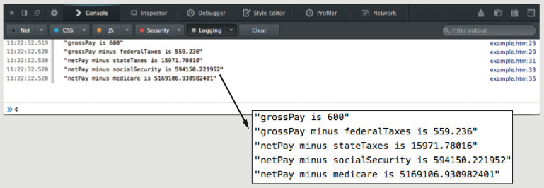
Tracing Errors with the console.log() Method
Figure 4-11 Contents of the console after executing the calculatePay() function

Slide 53
Using Comments to Locate Bugs
Another method of locating bugs
“Comment out” problematic lines
Helps isolate statement causing the error
When error message first received
Start by commenting out only the statement specified by the line number in the error message
Continue commenting lines until error eliminated

Slide 54
Combining Debugging Techniques
Combine debugging techniques
Aid in search for errors
Example:
Use comments combined with an alert box or log message to trace errors in the calculatePay() function

Slide 55
Combining Debugging Techniques
^{function calculatePay() {}
^{var payRate = 15;}
^{var numHours = 40;}
var grossPay = payRate * numHours;
^{window.alert(grossPay);}
// var federalTaxes = grossPay * .06794;
// var stateTaxes = grossPay * .0476;
// var socialSecurity = grossPay * .062;
// var medicare = grossPay * .0145;
// var netPay = grossPay – federalTaxes;
^{// netPay *= stateTaxes;}
^{// netPay *= socialSecurity;}
^{// netPay *= medicare;}
^{// return Math.round(netPay);}
}

Slide 56
Dependencies
Relationship in which one statement depends on another statement executing successfully
Can make debugging more challenging
Important to retest program after fixing a bug to ensure other parts aren't affected by change

Slide 57
Tracing Errors with Debugging Tools
Available in current versions of all modern browsers
Internet Explorer (IE)
Chrome
Firefox
Accessible through same panel that opens when you use the console
Examining code manually
Usually first step taken with a logic error
Works fine with smaller programs
Debugging tools
Help trace each line of code
More efficient method of finding and resolving logic errors

Slide 58
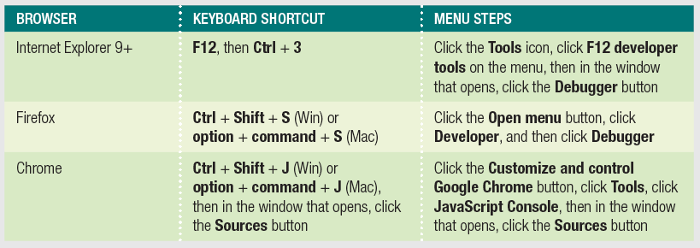
Understanding the IE, Firefox, and Chrome Debugger Windows
Using Debugger Windows
Open a document to debug in a browser
Use keyboard shortcut or menu to open debugger
Table 4-1: Steps to open debuggers in IE, Firefox, and Chrome

Slide 59
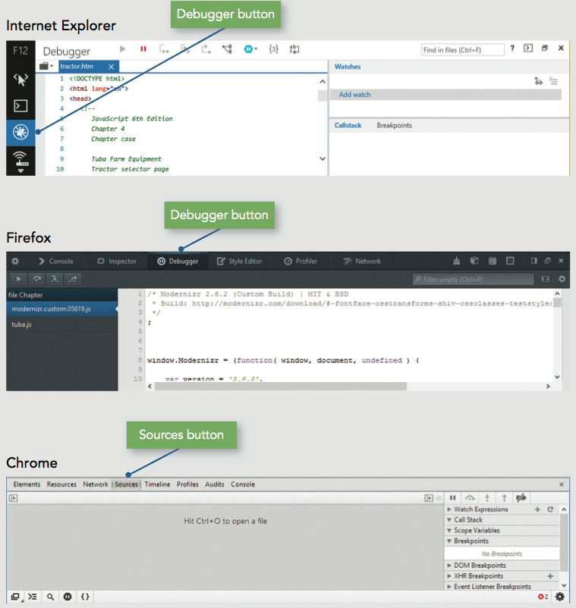
Understanding the IE, Firefox, and Chrome Debugger Windows
Internet Explorer
Shows HTML code by default
Click View sources to select a different file

Slide 60
Understanding the IE, Firefox, and Chrome Debugger Windows
Firefox
Lists JavaScript files alphabetically
Click a filename to see its contents

Slide 61
Understanding the IE, Firefox, and Chrome Debugger Windows
Chrome
Displays no files by default
press Ctrl + O (Win) or command + O (Mac) to select from list of associated files

Slide 62
Setting Breakpoints
Break mode
Temporary suspension of program execution
Used to monitor values and trace program execution
Breakpoint
Statement where execution enters break mode
When program paused at a breakpoint
Use debug tools to trace program execution

Slide 63
Setting Breakpoints
To set a breakpoint
Click the line number of the statement where execution should stop
Resume button (Firefox/Chrome), Continue button (IE)
Executes rest of the program normally or until another breakpoint encountered

Slide 64
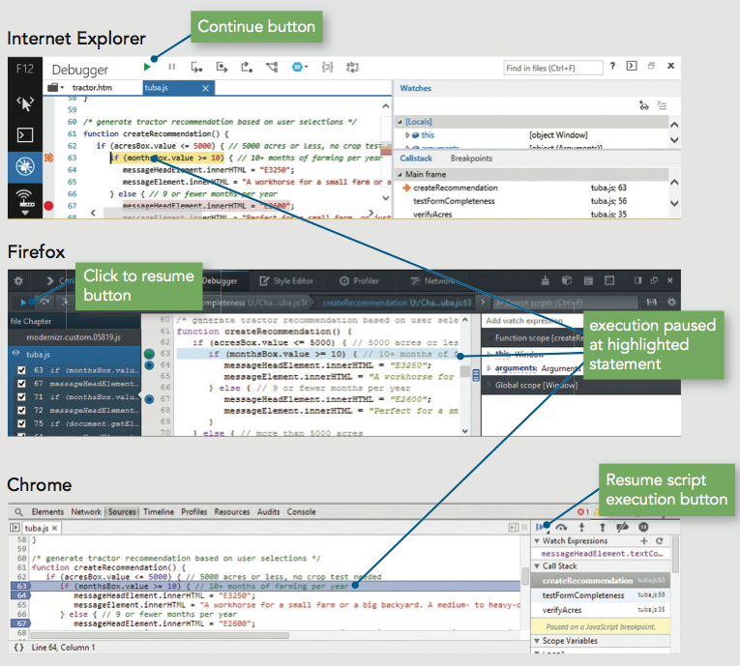
Setting Breakpoints
Figure 4-20 tuba.js execution stopped at the line 63 breakpoint

Slide 65
Clearing Breakpoints
To clear a breakpoint
Click the line number
To clear all breakpoints
Right-click any breakpoint
Click "Remove all breakpoints" or "Delete all"

Slide 66
Stepping Through Your Scripts
Stepping into
Executes an individual line of code
Pauses until instructed to continue
Debugger stops at each line within every function
Stepping over
Allows skipping of function calls
Program still executes function stepped over
Stepping out
Executes all remaining code in the current function
Debugger stops at next statement in the calling function

Slide 67
Tracing Variables and Expressions
Variables list
Displays all local variables within the currently executing function
Shows how different values in the currently executing function affect program execution
Watch list
Monitors variables and expressions in break mode

Slide 68
Tracing Variables and Expressions
To access watch list
IE
Displayed by default on right side of pane
In break mode, local and global variables displayed
Firefox
Click Expand Panes button
Shows watch and variables list on right side of pane
Chrome
Displayed by default on right side of pane

Slide 69
Tracing Variables and Expressions
To add an expression to the watch list
Locate an instance of the expression in the program
Select it and copy it to the Clipboard
Click "Click to add" (IE) or "Add watch expression (Firefox or Chrome)
Paste expression from Clipboard
Press Enter

Slide 70
Examining the Call Stack
Call stack
Ordered lists of which procedures (functions, methods, event handlers) have been called but haven't finished executing
Each time a program calls a procedure:
Procedure is added to the top of the call stack
IE and Chrome
Call stack list displayed to right of code
Firefox
Call stack list displayed above code

Slide 71
Handling Exceptions and Errors
Bulletproofing
Writing code to anticipate and handle potential problems
One bulletproofing technique is to validate the submitted form data
Exception handling
Allows programs to handle errors as they occur in program execution
Exception is an error occurring in a program

Slide 72
Throwing Exceptions
Execute code containing an exception in a try statement
throw statement
Specifies an error message in case an error that occurs within a try block
try {
var lastName = document.getElementById("lName").value;
if (lastName === "") {
throw "Please enter your last name.";
}
}

Slide 73
Catching Exceptions
Use a catch statement
Handles, or “catches” the error
Syntax:
catch(error) {
statements;
}
Example:
catch(lNameError) {
window.alert(lNameError);
return false;
}

Slide 74
Executing Final Exception Handling Tasks
finally statement
Executes regardless of whether its associated try block throws an exception
Used to perform some type of cleanup
Or any necessary tasks after code evaluated with a try statement

Slide 75
Implementing Custom Error Handling
Primary purpose of exception handling
Prevent users from seeing errors occurring in programs
Provide graceful way to handle errors
Reason for using exception handling with JavaScript
Evaluate user input
Programmers may write their own error-handling code
Can write user-friendly messages
Provides greater control over any errors

Slide 76
Implementing Custom Error Handling
Catching errors with the error event
Executes whenever error occurs on a Web page
Name of function to handle JavaScript errors
Assigned as event listener for error event
Preventing the Web browser from executing its own error handling functionality
Return return a value of true from the error event handler function

Slide 77
Implementing Custom Error Handling
Writing custom error-handling functions
JavaScript interpreter automatically passes three arguments to the custom error handling function
Error message, URL, line number
Use these values in custom error handling function
By adding parameters to the function definition
Use parameters in the function
Show a user the location of any JavaScript errors that may occur

Slide 78
Additional Debugging Techniques
Includes
Checking HTML elements
Analyzing logic
Testing statements with console command line
Using the debugger statement
Executing code in strict mode
Linting
Reloading a Web page

Slide 79
Checking HTML Elements
If a bug cannot be located using methods described in this chapter:
Perform a line-by-line analysis of the HTML code
Ensure all necessary opening and closing tags included
Use code editor specialized for web development
Highlights syntax errors as you type
Use the W3C Markup Validation Service to validate a Web page

Slide 80
Analyzing Logic
Some JavaScript code errors stem from logic problems
Can be difficult to spot using tracing techniques
Analyze each statement on a case-by-case basis

Slide 81
Testing Statements with the Console Command Line
Console command line
Testing and executing JavaScript statements
Without HTML document or JavaScript source file
Useful if trying to construct the correct syntax for a mathematical expression
Enter JavaScript statement at command line in web browser’s console
Including multiple statements at the command line
Separate statements with a semicolon

Slide 82
Using the debugger statement
When you include the debugger statement in your code
web browser stops executing JavaScript code when it reaches the debugger statement
equivalent of a breakpoint that's part of your JavaScript code

Slide 83
Using Strict Mode
Strict mode
Removes some features from JavaScript
Requires more stringent syntax for other features
Example: must always use var to declare variables
Many removed or altered features in strict mode are known to cause hard to find bugs
Include statement "use strict";
Including at start of script section requests strict mode for all code in that section
Including at start of code block in function requests strict mode just for that function

Slide 84
Linting
Running code through a program that flags some common issues that may affect code quality
jslint is a commonly used linting program
Similar result to using strict mode, but generates a report containing line numbers

Slide 85
Reloading a Web Page
Usually click the browser Reload or Refresh button
Web browser cannot always completely clear its memory
Remnants of an old bug may remain
Force web page reload
Hold Shift key and click the browser’s Reload or Refresh button
May need to close browser window completely
May need to delete frequently visited web pages

Slide 86
Summary
Array
Set of data represented by a single variable name
Index: element’s numeric position within the array
Can access and modify array elements
length property
number of elements in an array
Loop statements
while statements, do/while statements, and for statements
Iteration: each repetition of a looping statement
Counter: variable
Incremented or decremented with each iteration of a loop statement
continue statement
Restarts a loop with a new iteration

Slide 87
Summary
Decision making
Determining the order in which statements execute in a program
May execute in a linear fashion
if statement,if/else statement, else if construction
Nested decision-making structures
switch statement and case labels
break statement: used to exit control statements
Command block
Set of statements contained within a set of braces
May repeat the same statement, function, or code section

Slide 88
Summary
Three types of program errors
Syntax errors, run-time errors, logic errors
Error messages
First line of defense in locating bugs
Tracing
Examination of individual statements in an executing program
Using console.log() method to trace bugs
Helpful to use a driver program
Browser debugging tools

Slide 89
Summary
Break mode
Temporary suspension of execution to monitor values and trace execution
Breakpoint: statement in the code at which program execution enters break mode
Stepping into, stepping over, and stepping out
Variables list and watch list
Call stack
List of procedures that have started but not finished

Slide 90
Summary
Bulletproofing
Writing code to anticipate, handle potential problems
Exception handling
try, throw, catch, finally statements
JavaScript includes an error event
Executes whenever an error occurs on a web page
Additional debugging methods and techniques
Checking HTML elements, analyzing logic, console command line, debugger statement, strict mode, linting, and reloading a web page

Slide 91
Exercise
What type of error occurs when the interpreter fails to recognize the code?
What type of error occurs when JavaScript interpreter encounters a problem while a program is executing?
Modify your “Lunch Selections” program to log each user selection to the JavaScript console.
Debug your “Lunch Selections” program by putting a breakpoint in the function that counts the number of user menu selections.

Slide 92
Homework
Review and compare FireFox Page Inspector and Chrome DevTools Inspector. What differences do you find? Which tool do you find easier to use?
https://developers.google.com/web/tools/chrome-devtools/?hl=en
https://developer.mozilla.org/en-US/docs/Tools/Page_Inspector
Be prepared to present your findings on the next day of classes.

